Slide 1
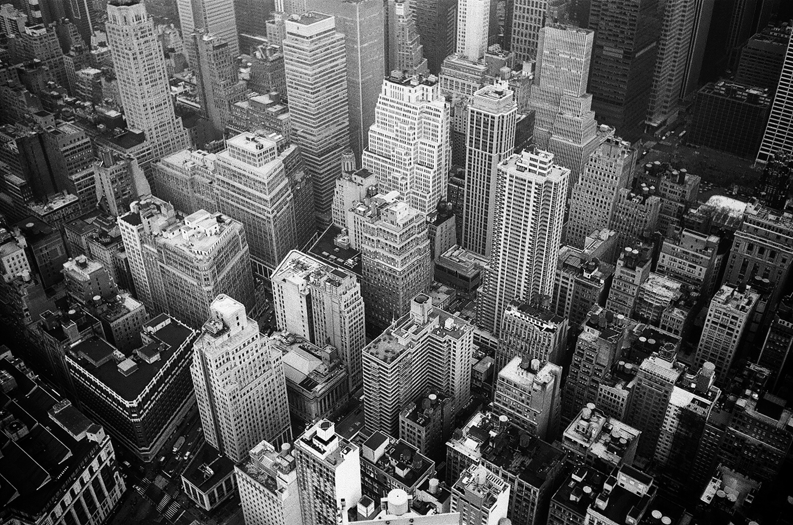
Improving Building Energy Performance
Greengineers
Team 40 Studio Sprint I Presentation
September 27, 2019

Slide 2








About Us
Fabio Daiber
MBA ‘20
Ruozhu Li
ORIE ‘20
Alan Babushkin
ECE ‘20
Ross (Ziyu) Liu
CS ‘20
Mahshid Moghadasi
AAP ‘21
We are the Greengineers, a perfectly mixed team of 5 students who want to drive sustainability innovation
Our
Partner

Slide 3

The Challenge
“How might we optimize and monitor energy performance to lessen the environmental impact of existing buildings?”

Slide 4
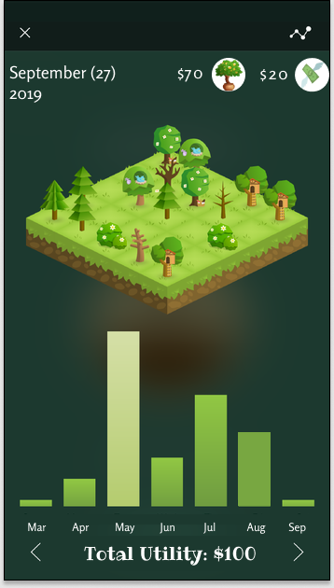
Energific
Daily challenges and energy saving suggestions
You saved:
$50!!!
How it works
Takes meteorological data
Gives daily suggestions to save energy in a fun and engaging way
Challenges and peer rankings
Notes:
During our research we understood that there has already been lots of innovative ideas for buildings created out there that can help us save energy. From solar panels, algae facades, green roofs to smart homes.
But people just don’t use them. Imagine you're a home owner, you get your electricity bill, but it doesn't tell you anything specific. Also sometimes People don’t know that these ways exist. more importantly people don’t know that “they” “themselves” are playing a very important role in saving energy and the planet.
“Energific” is an application that gives the user simple daily recommendations based on daily information on climate, wind, temperature, sun angle, etc. Recommendations like “Today’s temperature is 16 degrees! Turn the AC off, open the window, get some fresh air and save 3$!” and when they implement the recommendation, they will be rewarded with: “yaaaay! You’re doing great! You just saved a tree! And 3$! “ At the end of the month, they will get a report on how much they saved with the help of the application.
The challenges can go even farther than that. The recommendation can be like “If you buy this product, you can save 20% more which is an extra 10$ a month”. There can even be team challenges in the neighborhood, like “building green roofs”. According to an experiment in Berlin, using a “green roof system”, there can be an indoor temperature reduction between 3 to 4 degrees Celsius. Imagine what happens if the temperature drops by 3 degrees in a whole neighborhood.
The data we need is publicly available, combined with users' personal energy consumption we can provide actionable suggestions to save energy!
“Energific” shows: Simple actions matter. Simple actions together, make magnificent changes!

Slide 5

Ai.re
Ai.re
40
Current room heat emission (kJ)
People
detected
14,000
Optimized room temperature in offices
How it works:
Sensors track occupancy
Control the AC settings
Network system harmonizes sensors
Optimizing the current room temperature
Notes:
Why is it important?
6% of electricity goes to air condition
117 million metric tons of carbon dioxide every year
Nearly half of American works complain that temperature of office
Image if you walk in the classroom in the morning , it is frezzing cold inside. You have to bring your jacket when it is still August. Don't worry. You are not alone. Nearly half of American works complain that temperature of office, which is set based on research on 40 year-old bwck in 1960s. We want to make the situation changed. Let me...
It has sensors detecting occupancies heat emission within the room. The center processer will gather data to control the ac to keep the room in optimized temperature, which save the electricity cost and improve overall satisfaction of people within the area. The network system will harmonize the temperature between rooms.

Slide 6
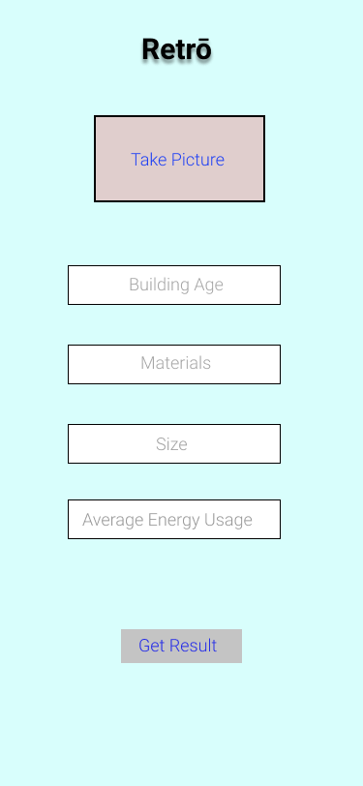
Retrō
Retrō
Specific retrofit recommendations in minutes
How it works:
Upload picture
Enter building info
Get retrofit recommendations incl. cost, savings and impact
Notes:
With the latest laws, NYC home owners need to save 40% of emissions by 2030
Imagine you own a small apartment complex and just heard about that law
You need to consider a retrofit of your building
How do you know where to start?
Instead of an expensive, lengthy building assessment, we propose a data-based way of doing it
We introduce: Retrö
Here’s how it works:
You take picture of your building -> an object detection algo recognizes building type
You need to enter basic information about the building: # of apartments, age, material, size, roof, annual energy consumption
Enter desired savings ($ and emission) or select “meet NYC Green Deal”
We recommend different solutions and how to get it done
Why can we do it:
Image object recognition exists
We can obtain data about energy consumption from the city/ gov
Buildings built in similar areas in similar times are most of the time very similar
Develop model to predict best solutions based on building characteristics
Future: provide DIY ideas
E.g. green roof and natural retrofits

Slide 7
Thank You
Greengineers

Slide 8
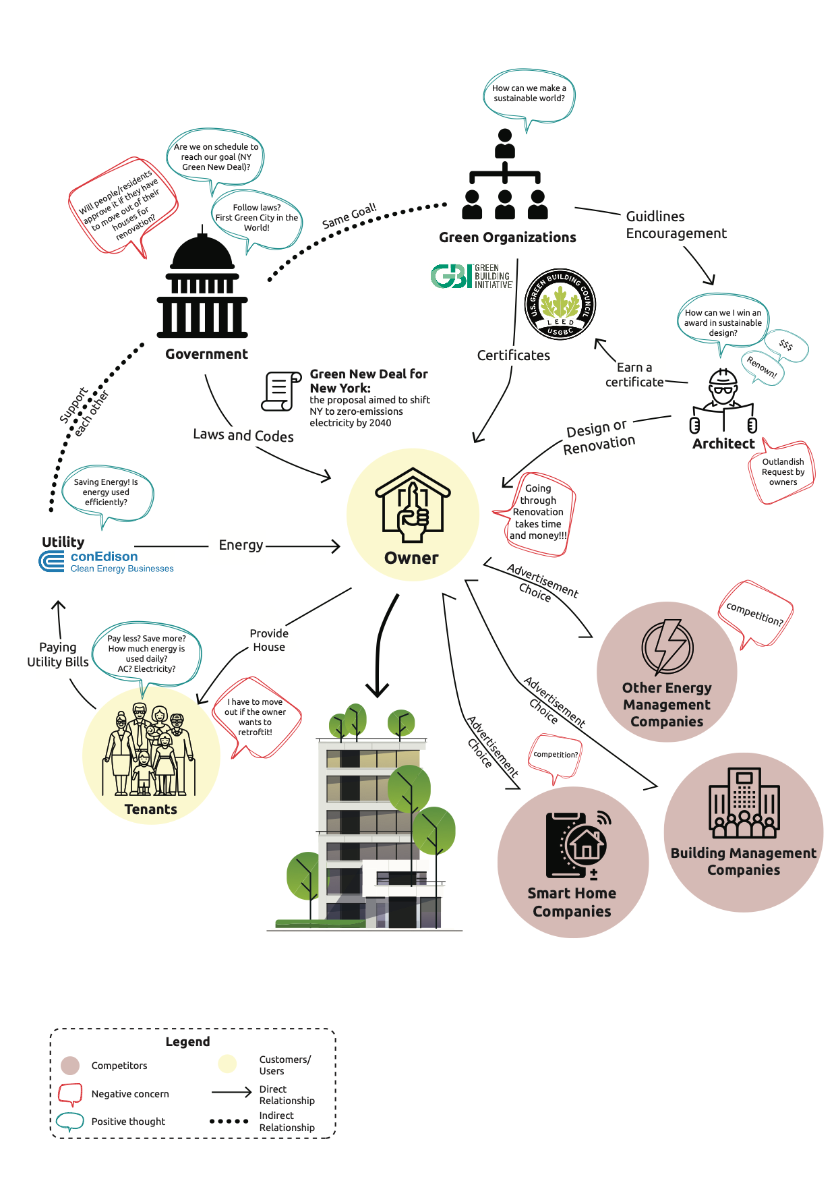
The Rich Picture
Building Owner
Building Tenants
Government
Our primary customer and likely partial user of our solution
Important stakeholder likely affected by our solution
Stakeholder that promotes retrofitting and sets regulations

